Slide 1
Practice 1
Introduction

Slide 2
Installing JDK
Double click on the JDK file
download JDK from the following link
http://www.oracle.com/technetwork/java/javase/downloads/index.html

Slide 3
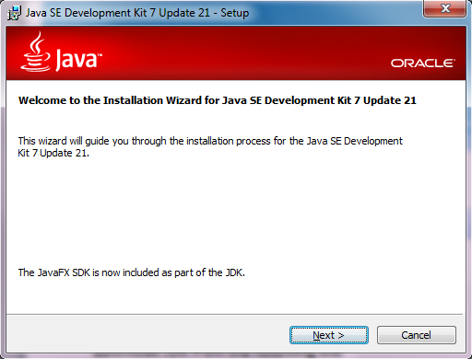
Installing JDK
Click on Next>
Click Me

Slide 4
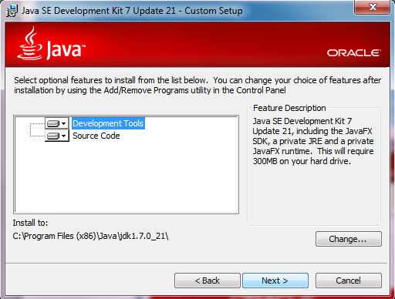
Installing JDK
Click Next

Slide 5
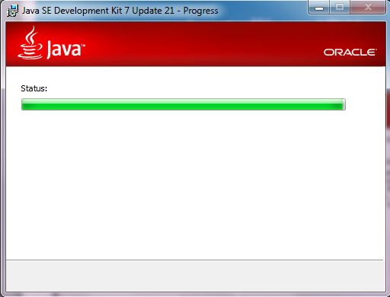
Installing JDK
Wait for me Please

Slide 6

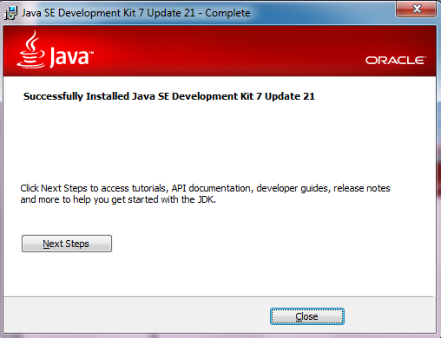
Installing JDK
Heyyyyyyy
I’m Done
Click on close

Slide 7
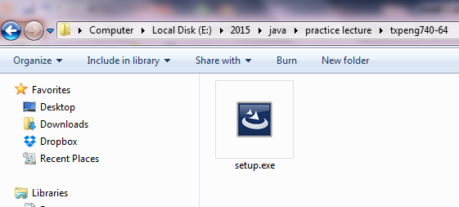
Installing TextPad
Double Click On Textpad
Download Link
http://www.textpad.com/download/#downloads

Slide 8
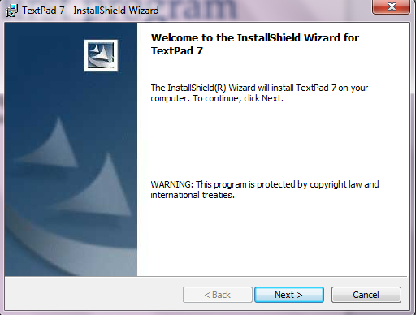
Installing TextPad
Click on Next>
Click Me

Slide 9
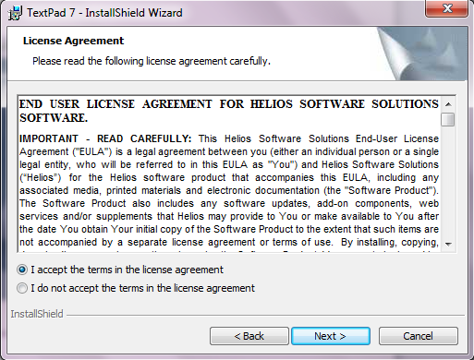
Installing TextPad
Click Me
Click on Next >
Click Me

Slide 10
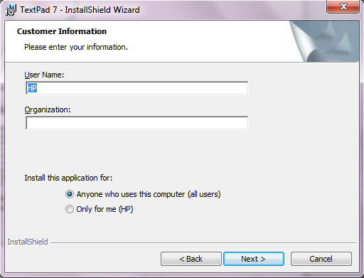
Installing TextPad
Click on Next>
Click Me

Slide 11
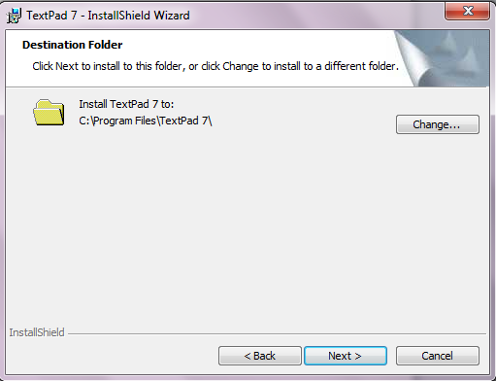
Installing TextPad
Click on Next>
Click Me

Slide 12
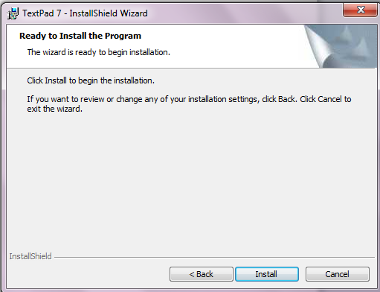
Installing TextPad
Click on Install
Click Me

Slide 13
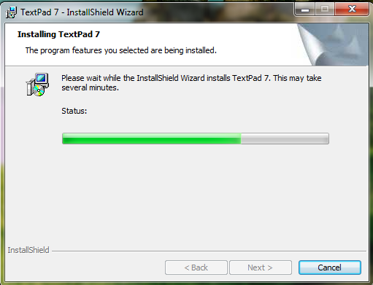
Installing TextPad
Wait for Me

Slide 14
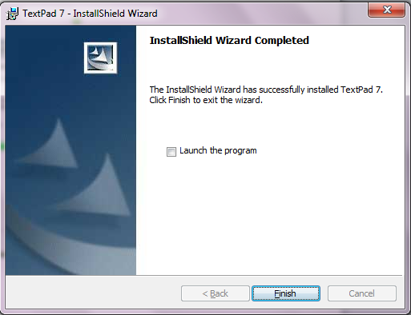
Installing TextPad
Click on Finish
Click Me

Slide 15
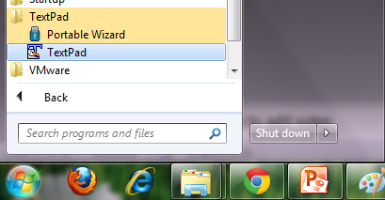
Installing TextPad
Start >> All Programs>> TextPad
Click Me

Slide 16
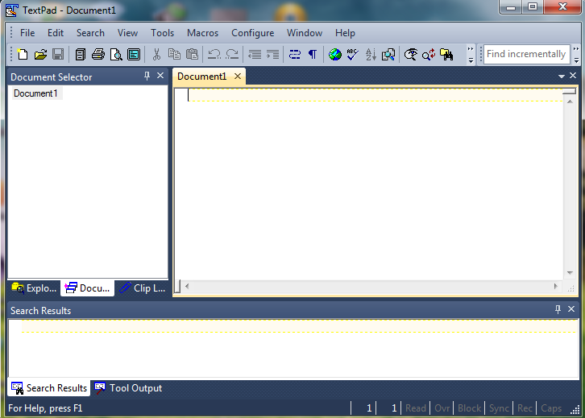
Write Your Code Here

Slide 17
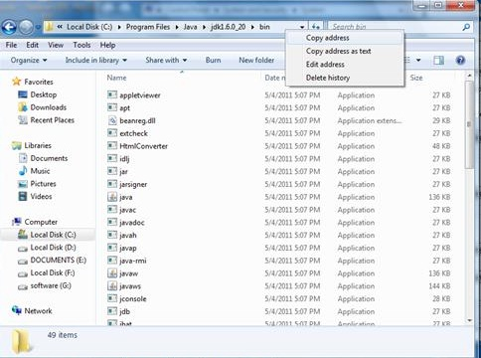
Setting Path of JDK in Windows:
In some JDK need to set path of the bin directory under JDK.
1. Copy the path of bin folder

Slide 18
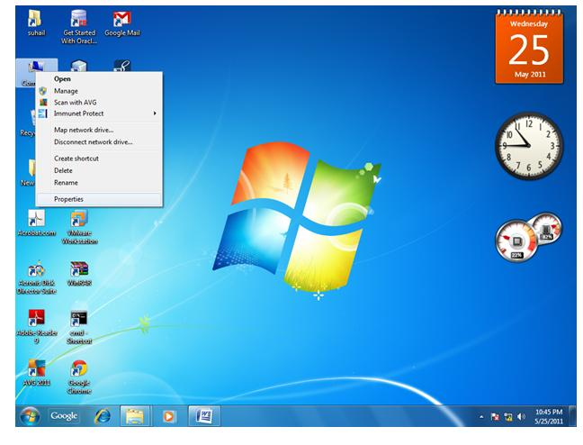
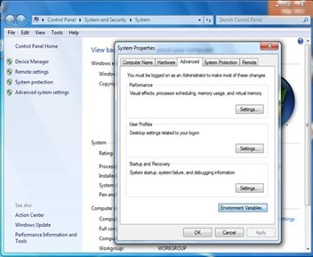
2. Go to My Computer properties -> advanced tab ->
environment variables -> new tab of user variable ->
write path in variable name ->
write path of bin folder in variable value -> ok -> ok ->

Slide 19
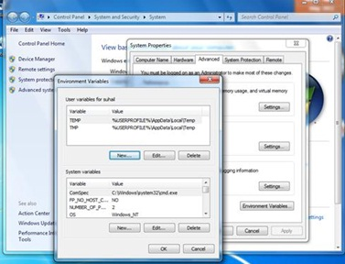
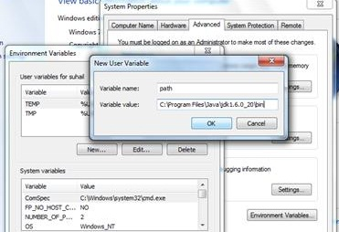
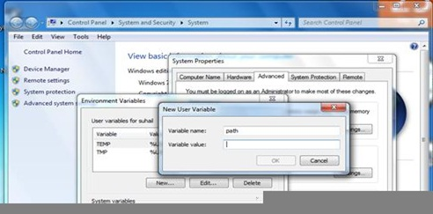

Slide 20
Sample Program
class Firstlec
{
public static void main(String Args[])
{
System.out.println("Hello university, First Stage");
}
}

Slide 21

Thank You

